Slide 1

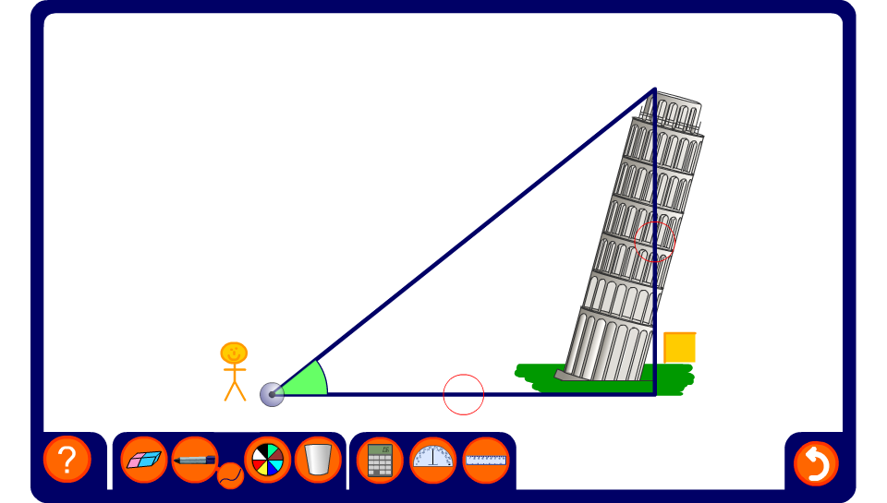


Angles of elevation
Notes:
Explain that an angle of elevation is the angle made between the horizon and the top of an object that you are looking up at. Explain that we can use an instrument to measure angles of elevation.
By measuring the angle of elevation from the ground to the top of a tall building we can apply trigonometry to determine the height of the building.
Hide either the angle of elevation, the height of the building or the distance of the foot of the building to the point of measurement. Ask pupils to use the tangent ratio to find the unknown measurements. Change the position of the observer to change the measurements.
Reset the activity to change the building.

